Slide 1




Ethical and Socially Responsible Behavior
S p e a k e r : Ta n i a A k t e r ( TA K )
L e c t u r e r , B B S , B R A C U n i v e r s i t y

Slide 2





Learning Objectives
E x p l a i n t h e c o n c e p t o f e t h i c s a n d e t h i c a l b e h a v i o r.
A s k t h e t h r e e q u e s t i o n s y o u n e e d t o a n s w e r w h e n f a c e d w i t h a
p o t e n t i a l l y u n e t h i c a l a c t i o n .
D e s c r i b e m a n a g e m e n t ’ s r o l e i n s e t t i n g e t h i c a l s t a n d a r d s .
D i s t i n g u i s h b e t w e e n c o m p l i a n c e - b a s e d a n d i n t e g r i t y - b a s e d e t h i c s c o d e s , a n d l i s t t h e s i x s t e p s i n s e t t i n g u p a c o r p o r a t e e t h i c s c o d e .
D e f i n e c o r p o r a t e s o c i a l r e s p o n s i b i l i t y a n d c o m p a r e c o r p o r a t i o n s ’
r e s p o n s i b i l i t i e s t o v a r i o u s s t a k e h o l d e r s .
A n a l y z e t h e r o l e o f U . S . b u s i n e s s e s i n i n f l u e n c i n g e t h i c a l b e h a v i o r a n d s o c i a l r e s p o n s i b i l i t y i n g l o b a l m a r k e t s .

Slide 3
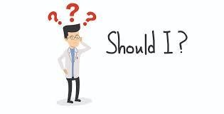
Ethics
Ethics • Ethics refers to the study of morals and
moral choices of human being.
The behavior of individuals and groups which are governed by standards, rules, and codes of conduct consist of the subjects covered by ethics.

Slide 4
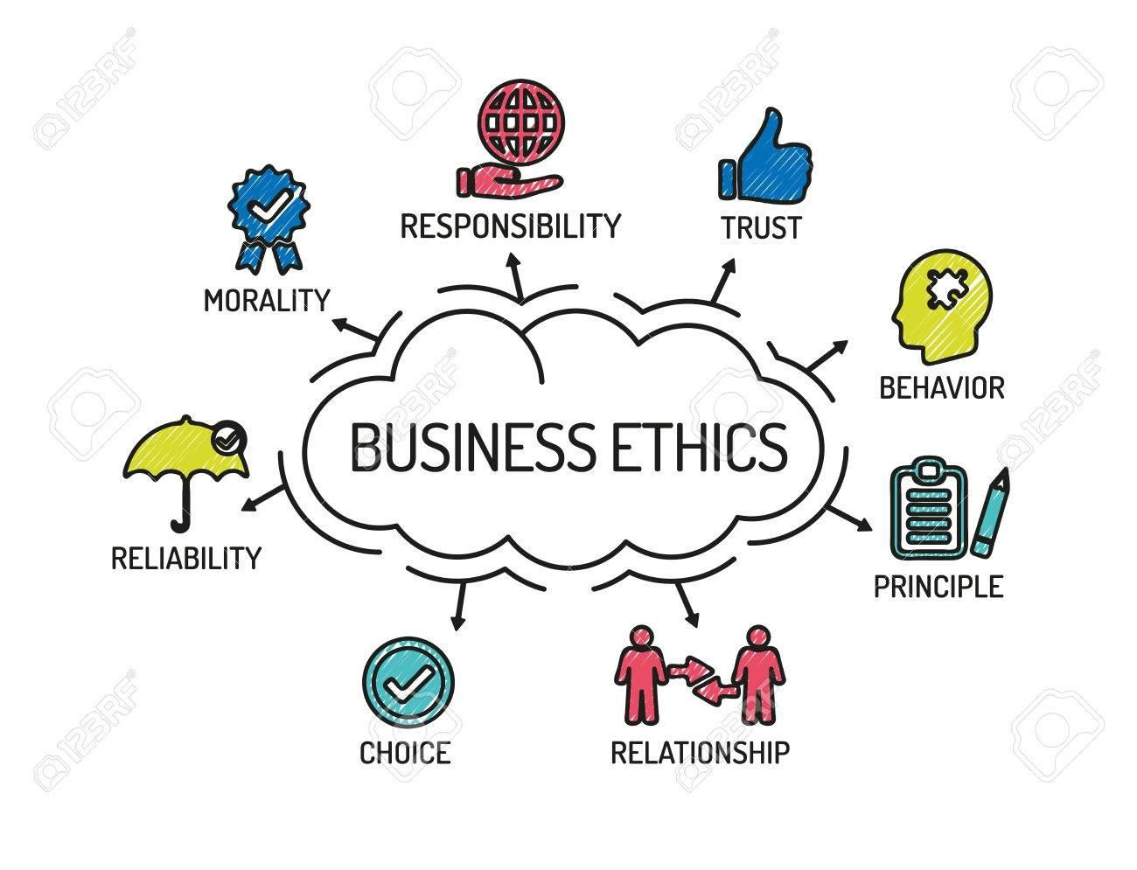
What is Business Ethics?
The moral principles defining right and wrong behavior of businesspersons and their agents •
It implores them to adhere to certain ethical conduct when dealing with anybody especially those affected by their business activities.

Slide 5


BLAKE MYCOSKIE TOMS Shoes
While appearing on The Amazing Race, Mycoskie saw how badly local children in Argentina needed shoes.He founded TOMS inTOMS gives a pair of shoes to a child in need for every pair sold.

Slide 6
BASIC MORAL VALUES Right: Wrong: Integrity Cheating Cowardice
Ethical Standards are Fundamental
Right:
Integrity
Respect for human life
Self-control
Honesty
Courage
Self-sacrifice
Wrong:
Cheating
Cowardice
Cruelty

Slide 7




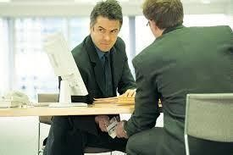

ETHICS and YOU
Ethics Begins with Each of Us
Plagiarizing from Internet materials is the most common form of cheating in schools today.
Studies found a strong relationship between academic dishonesty and dishonesty at work.
Caption03 appears here

Slide 8
FACING ETHICAL DILEMMAS
Ethics Begins with Each of Us
Ask yourself these questions: Is it legal?
Is it balanced?
How will it make me feel about myself?

Slide 9
How To Prevent Unethical Behavipr
Organizational ethics begin at the top.
Managers can help instill corporate values in employees.
Trust between workers and managers must be based on fairness, honesty, openness and moral integrity.
Leadership helps to instill corporate values in employees. So, like many aspects of business, ethical behavior practiced and modeled by managers and executives will often trickle down to the employees at large.
Managers must communicate the organization’s vision on ethical behavior.
Organizations must have a code of ethics.
Policies have to be enforced regarding ethical offences.
Ethical responsibility must be taught to all employees.

Slide 10
Steps to Improve Business Ethics
Top management support
Employees’ understanding
Managers’ training
Ethics Office- whistle blower
Outsiders must be informed
Enforcement of ethics code

Slide 11

Corporate Social Responsibility
Focuses on what an organisation does to
influence the society in which it exists.

Slide 12
Corporate Social Performance
The arena of social responsibility debates is shaped by
Economic responsibility – be profitable
Legal responsibility – obey the law
Ethical responsibility – be ethical. Do what is right. Avoid harm.
Discretionary responsibility: Contribute to the community and quality of life

Slide 13
Corporate Social Responsibility
Corporate philanthropy
Corporate social initiatives
Corporate responsibility
Corporate policy

Slide 14
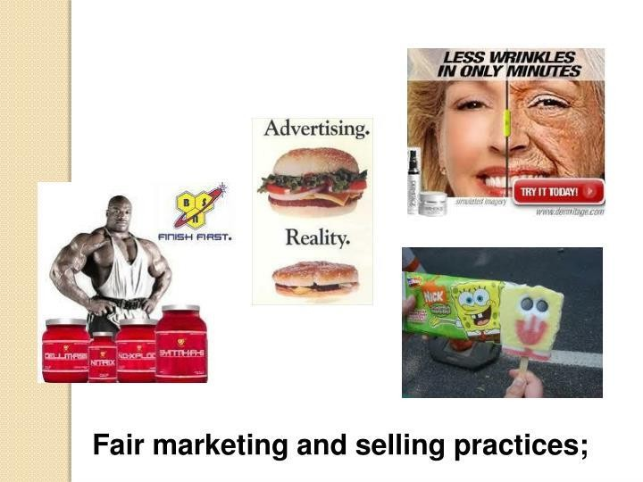
Fair marketing and selling practices

Slide 15
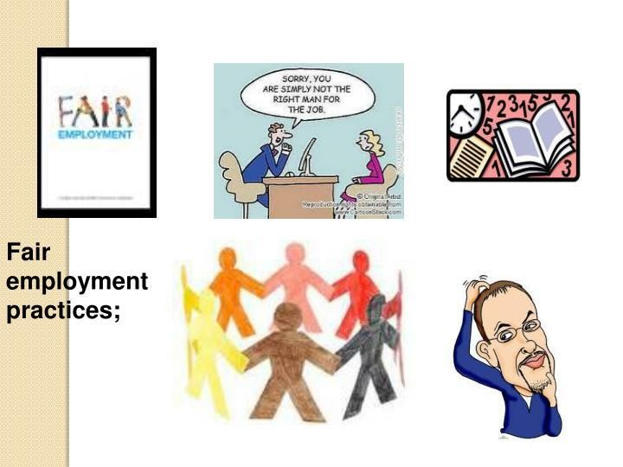
Fair employment practices

Slide 16
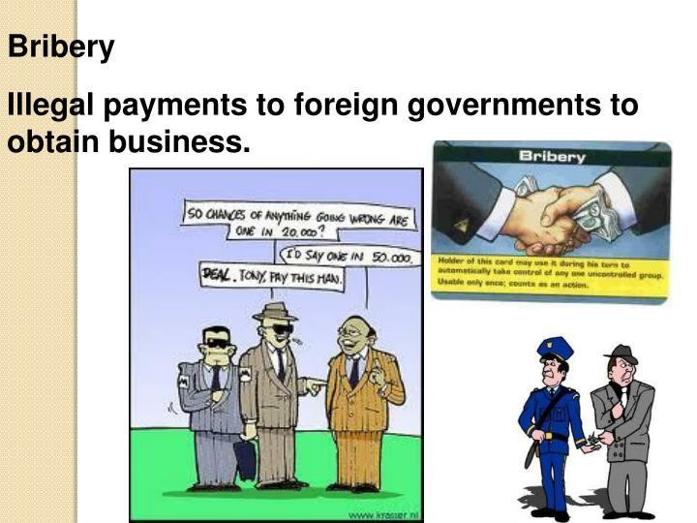
Bribery

Slide 17
Stakeholders to whom businesses are responsible
Responsibility to Customers
Right to safety
Right to be informed
Right to choose
Right to be heard
Responsibility to Investors – insider trading
Responsibility to Employees
Responsibility to society and the environment

Slide 18
SOCIAL AUDITING & ITS TYPES
Social Audit -- A systematic evaluation of an organization’s progress toward implementing programs that are socially responsible and responsive.
Four types of social audit watchdogs:
Socially conscious investors
Environmentalists- Bangladesh Environmental Lawyers Association
Union officials- “Garment Sromik Trade Union Kendro”.
Customers

